Slide 1

LLM Inference
Jinwei Yao, Tengjun Jin, Yuxuan Zhu

Slide 2
Part I: Efficient Memory Management for Large Language Model Serving with PagedAttention
Woosuk Kwon, Zhuohan Li, Siyuan Zhuang, Ying Sheng, Lianmin Zheng, Cody Hao Yu, Joseph E. Gonzalez, Hao Zhang, Ion Stoica
UC Berkeley
Stanford University
UC San Diego
Presenter: Tengjun Jin, Jinwei Yao

Slide 3
Outlines
Background(1-2 pages):
Huggingface TGI, DeepSpeed->continuous memory
Standard ML methods do not (explicitly) model relations
Motivation & Problem(1-2) Method (8)
paged
batching, etc
Evaluation (8)
Discussion(3-5)

Slide 4

Era of LLMs
LLM Applications
Programming
Chatting
Agents
Content Creation

Slide 5
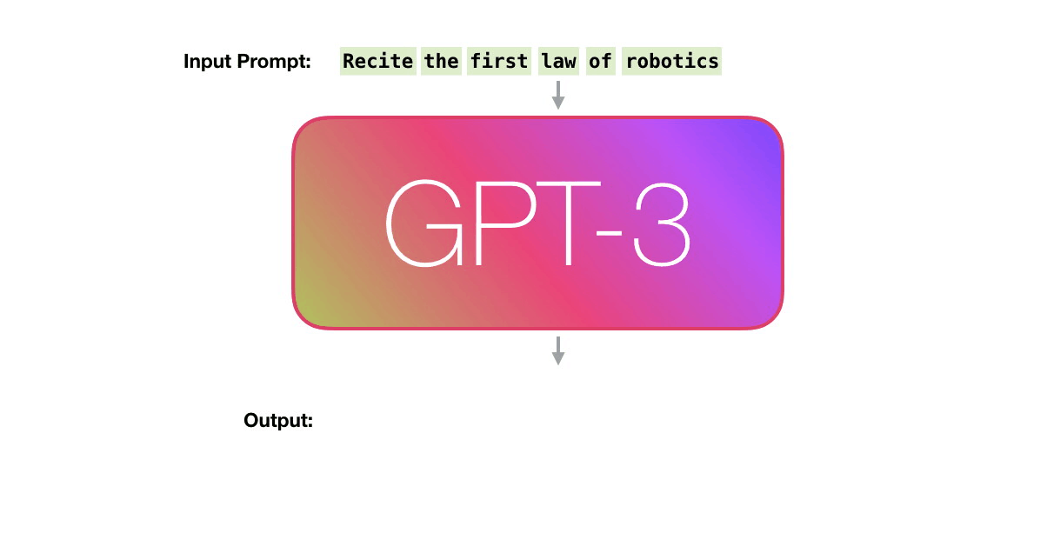
Autoregressive Generation

Slide 6
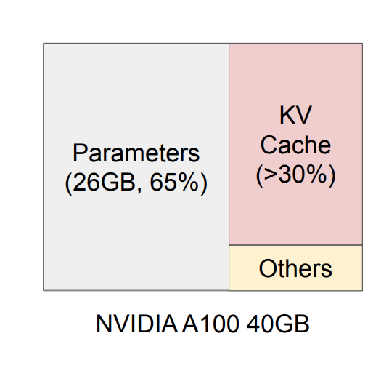
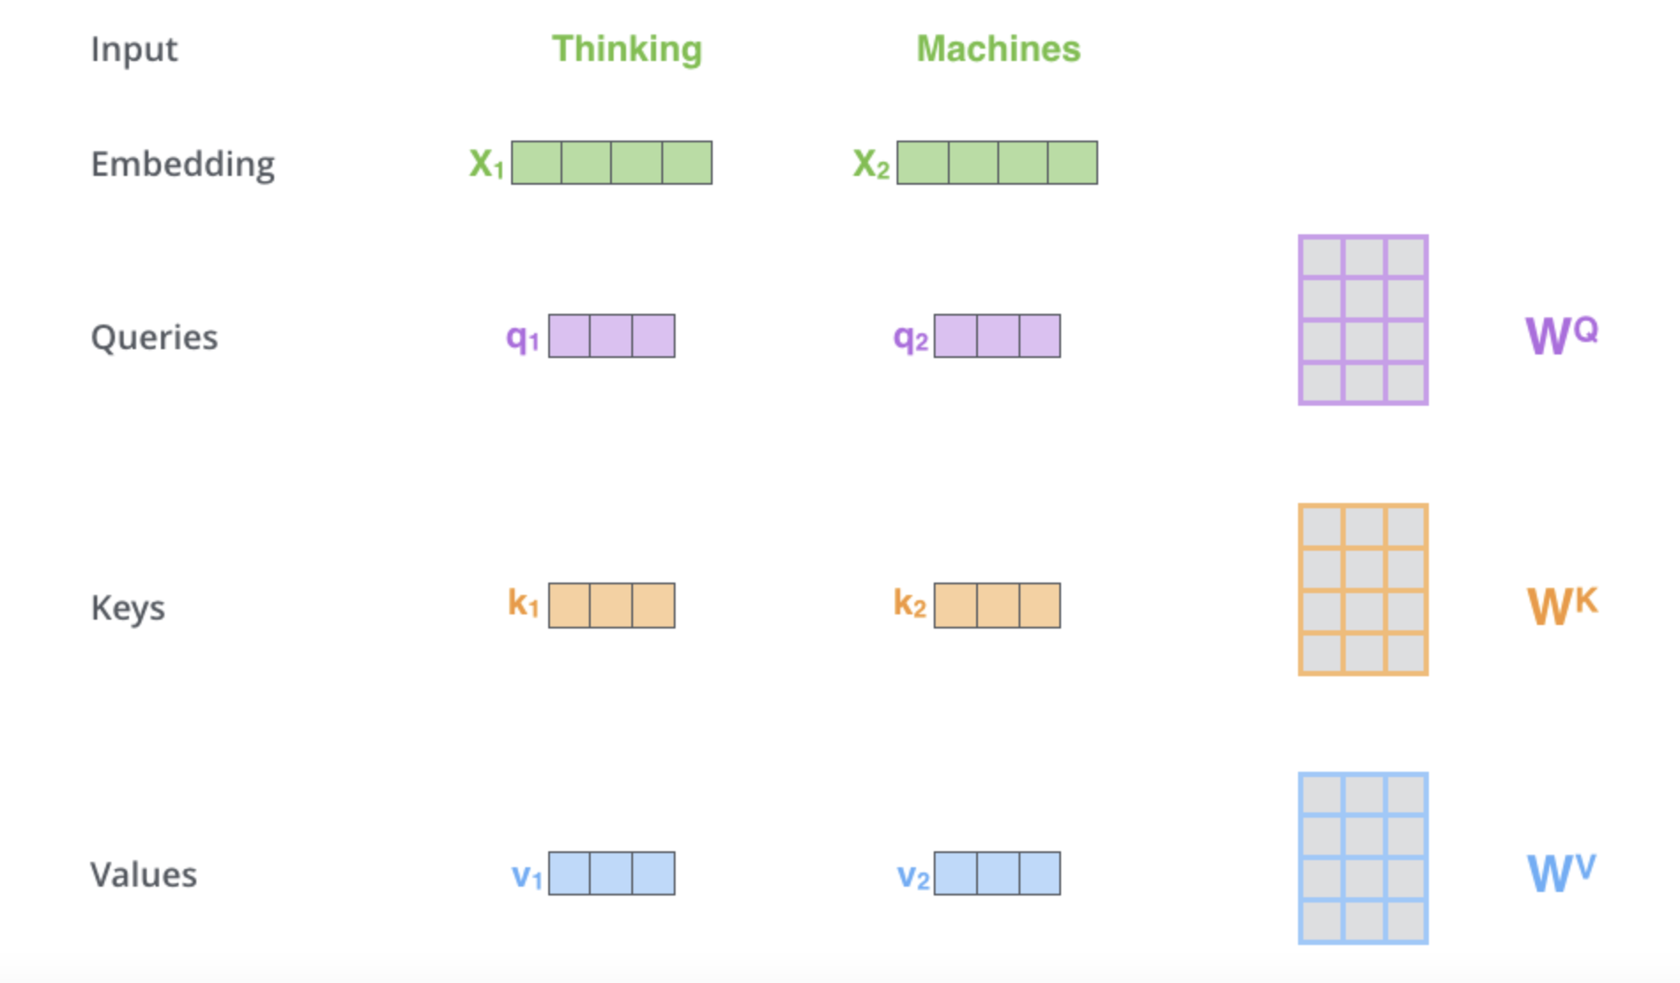
Autoregressive Generation
Serving an LLM with 13B parameters.

Slide 7
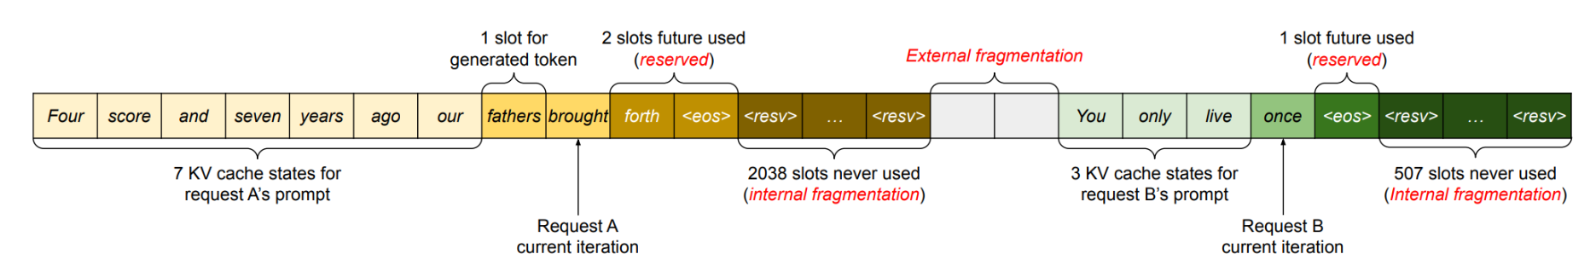
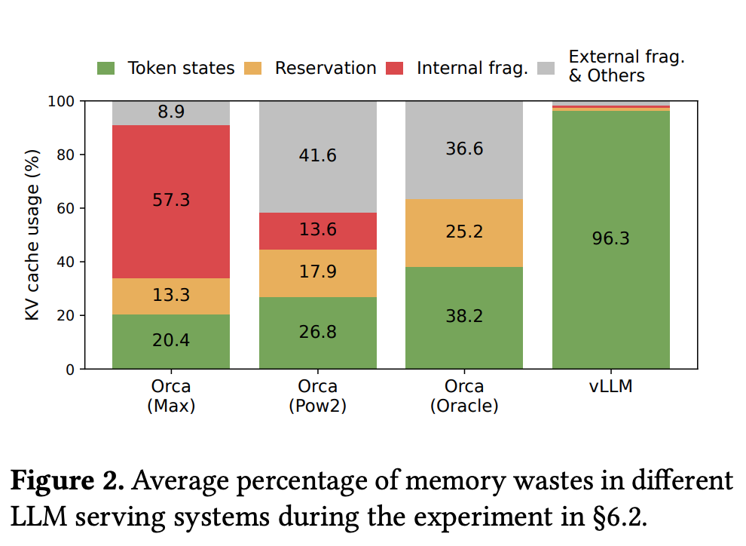
Autoregressive Generation
Memory Waste:
Reversed slots
Internal Fragmentation
External Fragmentation
Notes:
reserved slots for future tokens,
internal fragmentation due to over-provisioning for potential maximum sequence lengths,
and external fragmentation from the memory allocator like the buddy allocator.

Slide 8
Challenges
Large KV cache: limited requests allowed
Complex decoding algorithms: random samples, beam search
Unknown input & output lengths

Slide 9
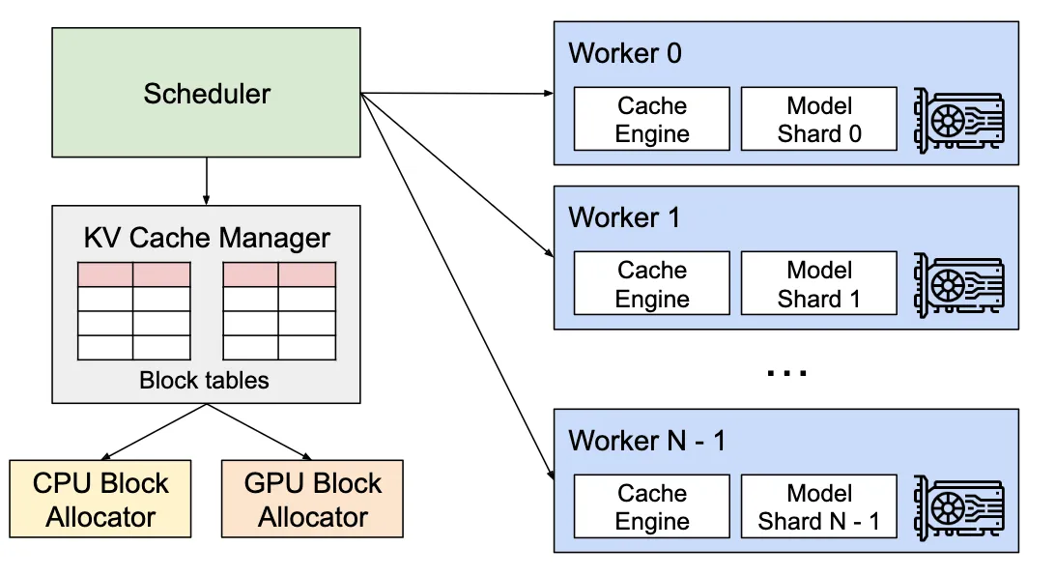
vLLM Serving Engine
Notes:
To tackle the challenges, we develop a new attention algorithm, PagedAttention, and build an LLM serving engine, vLLM. vLLM adopts a centralized scheduler to coordinate the execution of distributed GPU workers. The KV cache manager effectively manages the KV cache in a paged fashion, enabled by PagedAttention.

Slide 10
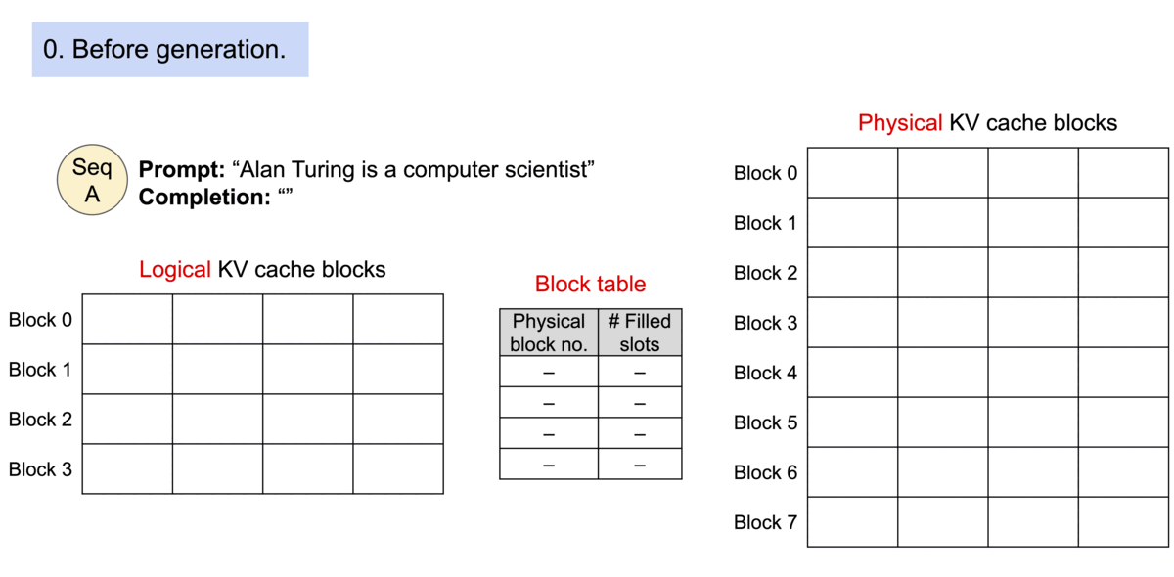
Paged Attention
Notes:
PagedAttention partitions the KV cache of each sequence into KV blocks. Each block contains the key and value vectors for a fixed number of tokens.
the PagedAttention algorithm allows the KV blocks to be stored in non-contiguous physical memory, which enables more flexible paged memory management in vLLM
As all the blocks are filled from left to right and a new physical block is only allocated when all previous blocks are full, vLLM limits all the memory wastes for a request within one block, so it can effectively use all the memory

Slide 11
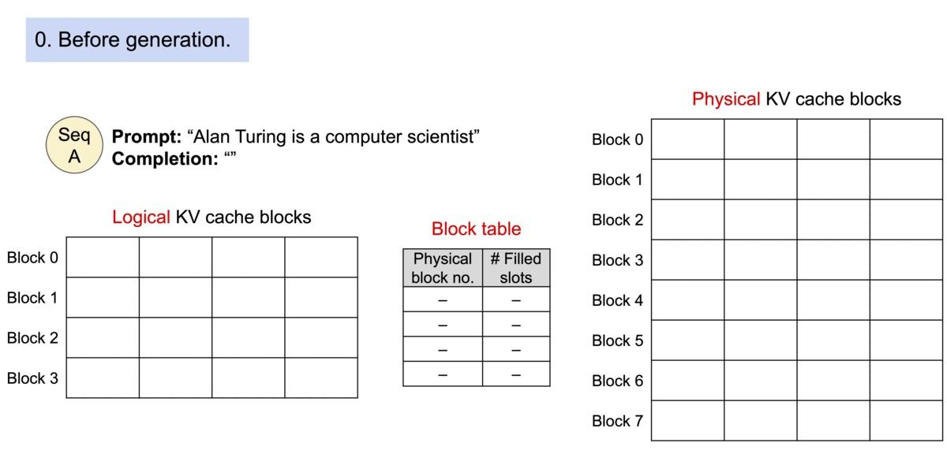
Paged Attention
Notes:
PagedAttention partitions the KV cache of each sequence into KV blocks. Each block contains the key and value vectors for a fixed number of tokens.
the PagedAttention algorithm allows the KV blocks to be stored in non-contiguous physical memory, which enables more flexible paged memory management in vLLM
As all the blocks are filled from left to right and a new physical block is only allocated when all previous blocks are full, vLLM limits all the memory wastes for a request within one block, so it can effectively use all the memory

Slide 12
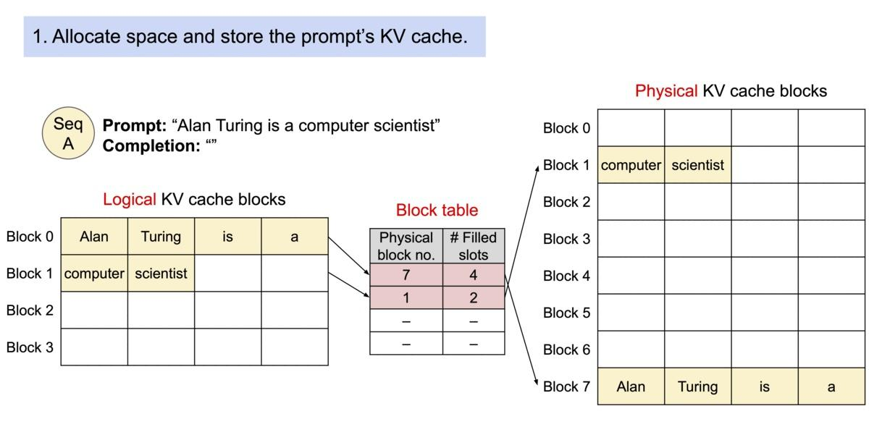
Paged Attention
Notes:
PagedAttention partitions the KV cache of each sequence into KV blocks. Each block contains the key and value vectors for a fixed number of tokens.
the PagedAttention algorithm allows the KV blocks to be stored in non-contiguous physical memory, which enables more flexible paged memory management in vLLM
As all the blocks are filled from left to right and a new physical block is only allocated when all previous blocks are full, vLLM limits all the memory wastes for a request within one block, so it can effectively use all the memory

Slide 13
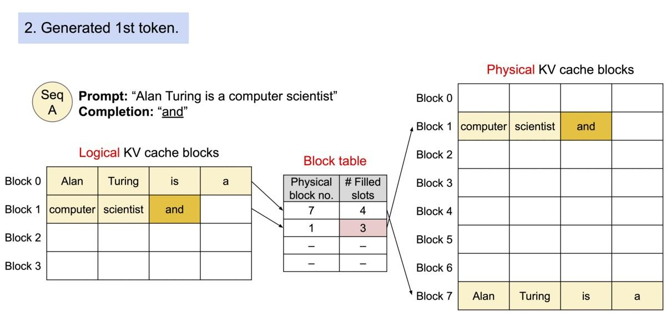
Paged Attention
Notes:
PagedAttention partitions the KV cache of each sequence into KV blocks. Each block contains the key and value vectors for a fixed number of tokens.
the PagedAttention algorithm allows the KV blocks to be stored in non-contiguous physical memory, which enables more flexible paged memory management in vLLM
As all the blocks are filled from left to right and a new physical block is only allocated when all previous blocks are full, vLLM limits all the memory wastes for a request within one block, so it can effectively use all the memory

Slide 14
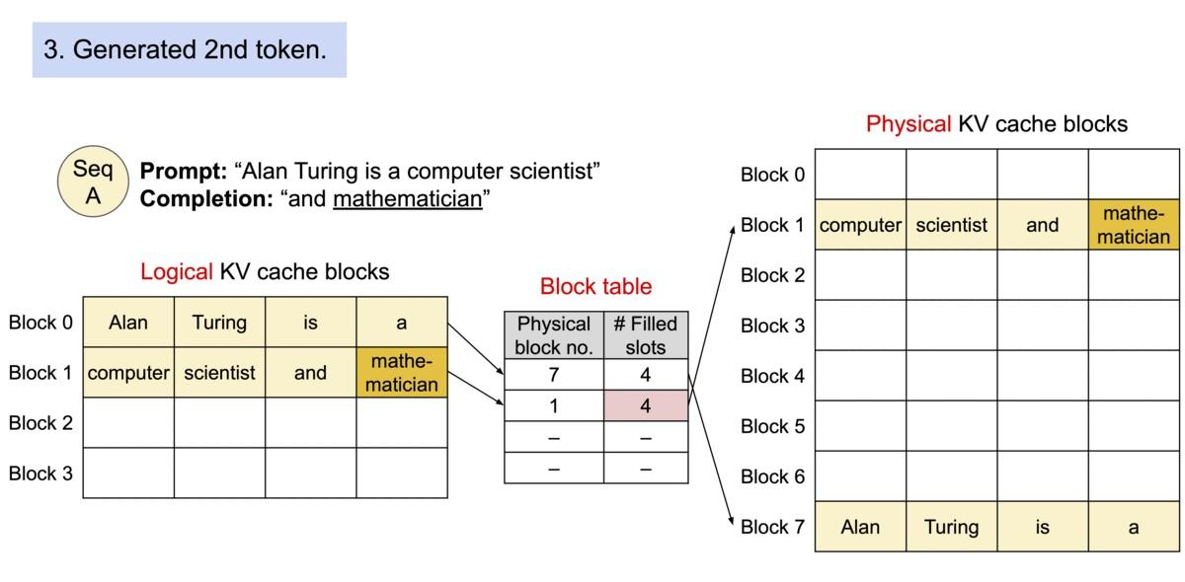
Paged Attention
Notes:
PagedAttention partitions the KV cache of each sequence into KV blocks. Each block contains the key and value vectors for a fixed number of tokens.
the PagedAttention algorithm allows the KV blocks to be stored in non-contiguous physical memory, which enables more flexible paged memory management in vLLM
As all the blocks are filled from left to right and a new physical block is only allocated when all previous blocks are full, vLLM limits all the memory wastes for a request within one block, so it can effectively use all the memory

Slide 15
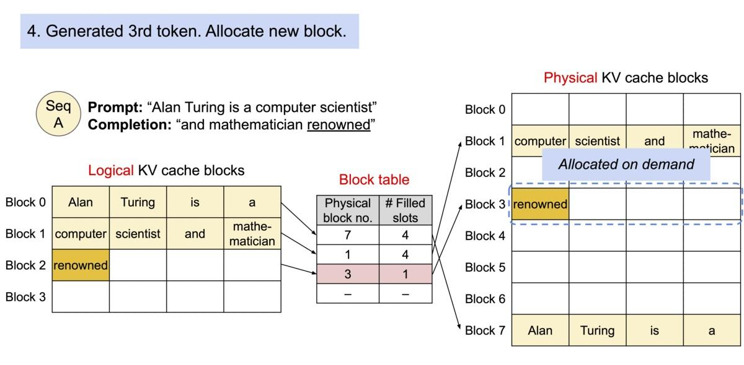
Paged Attention
Notes:
PagedAttention partitions the KV cache of each sequence into KV blocks. Each block contains the key and value vectors for a fixed number of tokens.
the PagedAttention algorithm allows the KV blocks to be stored in non-contiguous physical memory, which enables more flexible paged memory management in vLLM
As all the blocks are filled from left to right and a new physical block is only allocated when all previous blocks are full, vLLM limits all the memory wastes for a request within one block, so it can effectively use all the memory

Slide 16
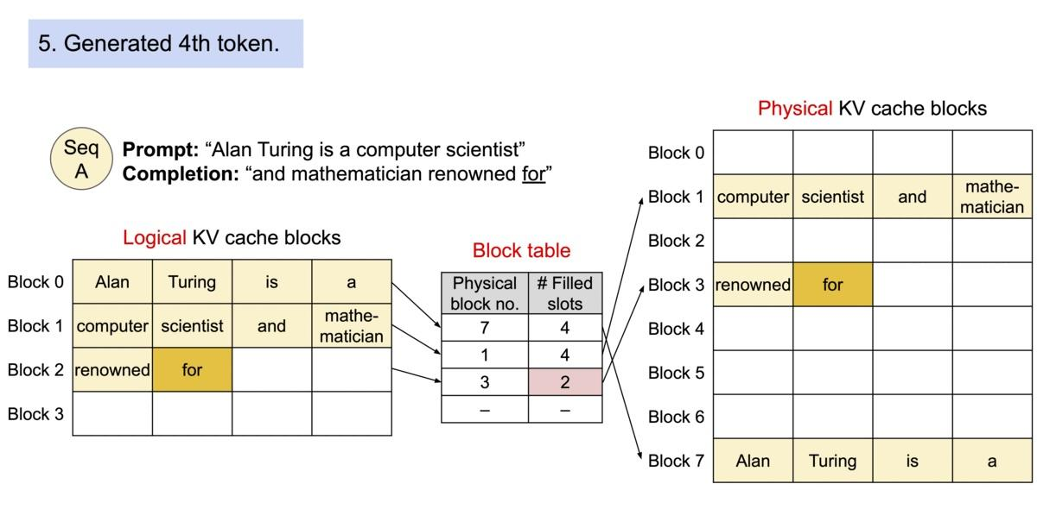
Paged Attention
Notes:
PagedAttention partitions the KV cache of each sequence into KV blocks. Each block contains the key and value vectors for a fixed number of tokens.
the PagedAttention algorithm allows the KV blocks to be stored in non-contiguous physical memory, which enables more flexible paged memory management in vLLM
As all the blocks are filled from left to right and a new physical block is only allocated when all previous blocks are full, vLLM limits all the memory wastes for a request within one block, so it can effectively use all the memory

Slide 17
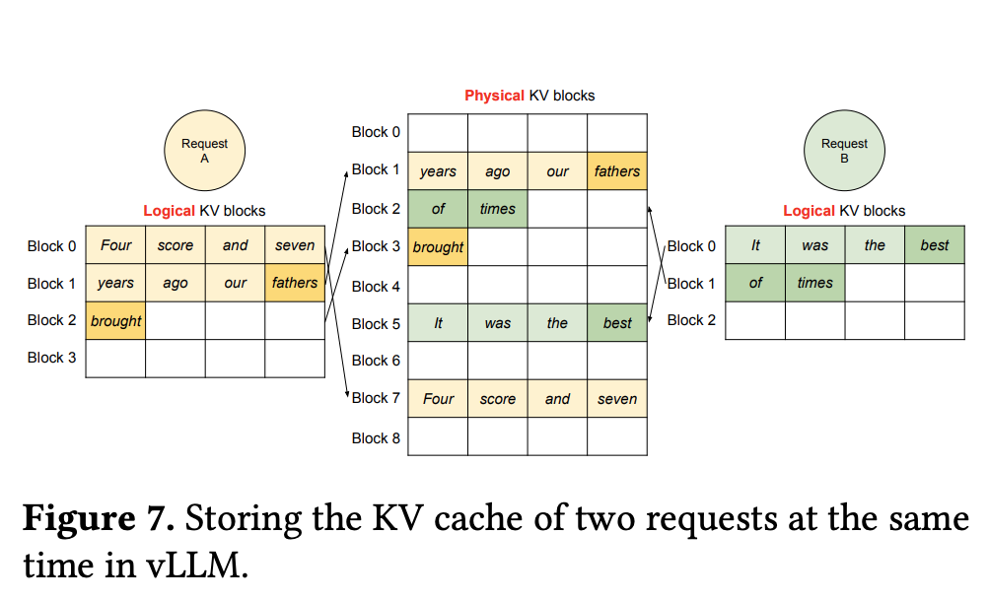
KV Cache of Two Requests
Notes:
The logical blocks of the two sequences are mapped to different physical blocks.The neighboring logical blocks of both sequences do not need to be contiguous in physical GPU memory

Slide 18
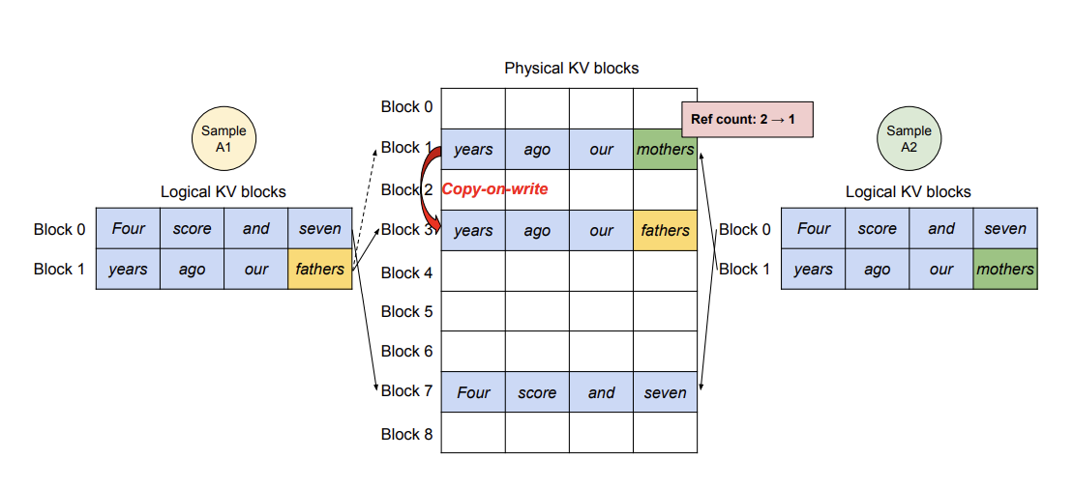
Parallel sampling

Slide 19
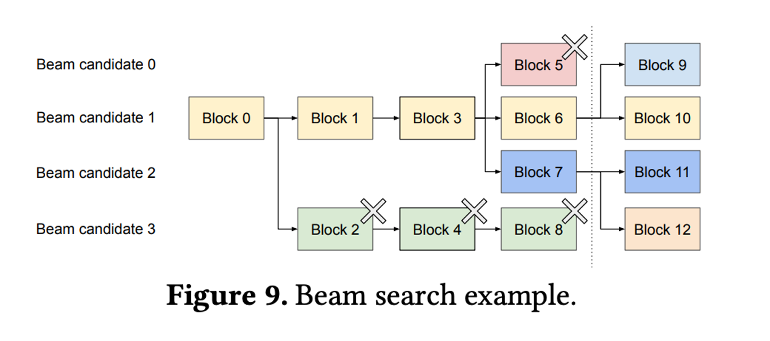
Beam Search

Slide 20
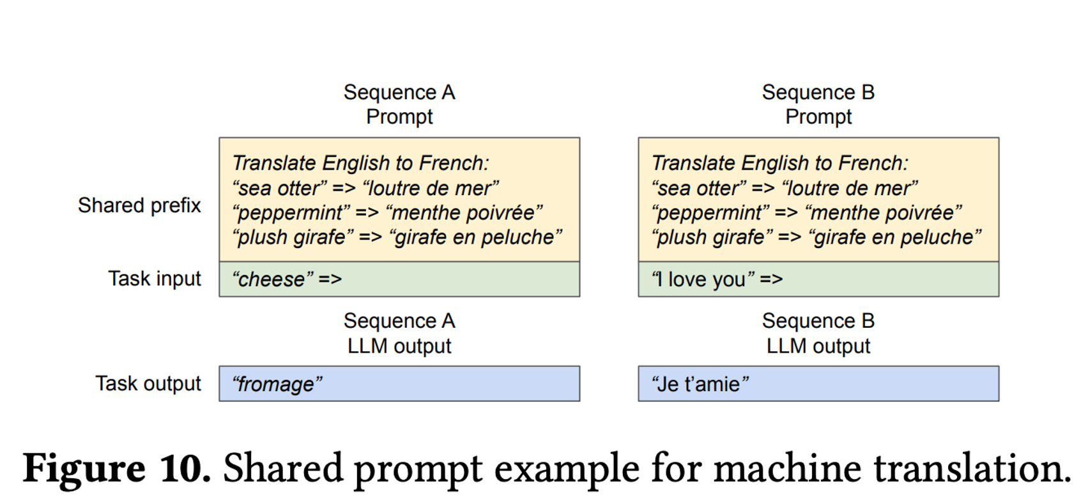
Shared Prefix

Slide 21
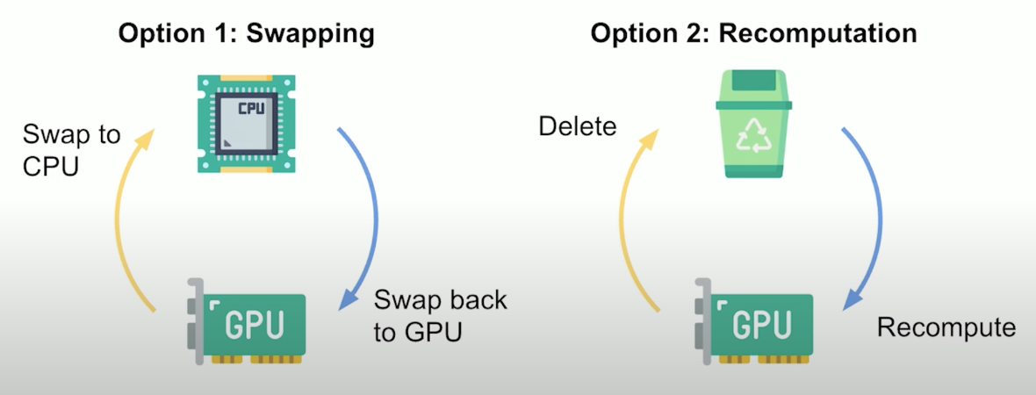
Scheduling and Preemption
Request traffic surpasses the system’s capacity
First-come-first-serve
Run out of the GPU’s physical blocks
All-or-nothing eviction policy
Recover by swapping or recomputation

Slide 22
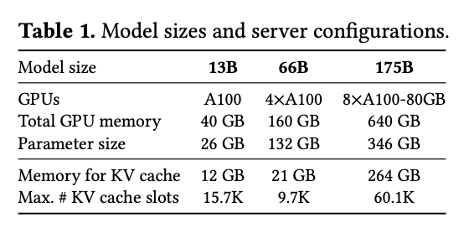
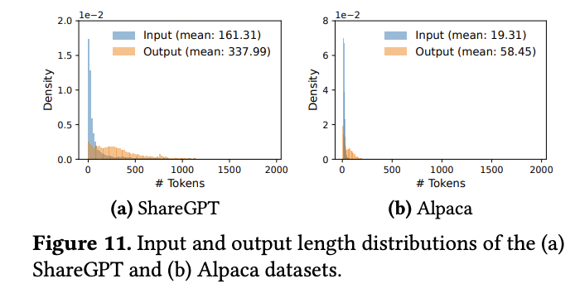
Evaluation-settings
Model: OPT models and LLaMA. See Table 1.
Workloads: ShareGPT and Alpaca. Length distribution on Figure.11.
Key metrics: serving throughput.
The workloads with different request rates
➡️ normalized latency—the mean of every request’s end-to-end latency divided by its output length

Slide 23
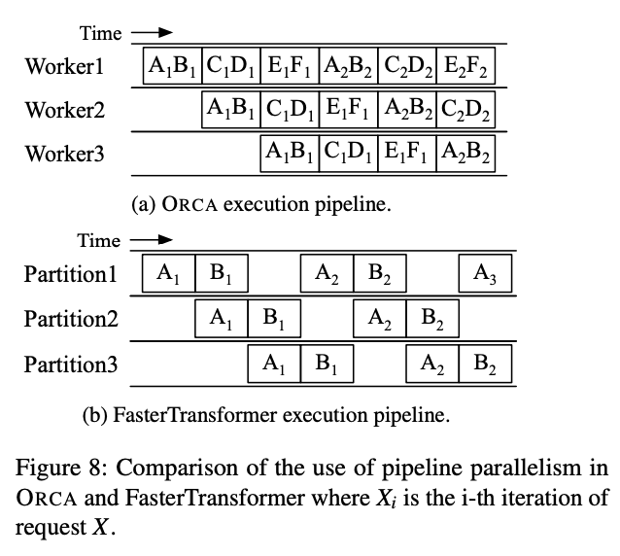
Evaluation-baselines
baselines
FastTransformer: a distributed inference engine highly optimized for latency.
Orca: the first work to adopt continuous/dynamic batching for high throughput.
Oracle: know exact length of requests to keep as performance upper-bound.
Pow2: over-reserve at most 2x space for the output.
Max: always preserve max length of the model. i.e, 2048 tokens.

Slide 24
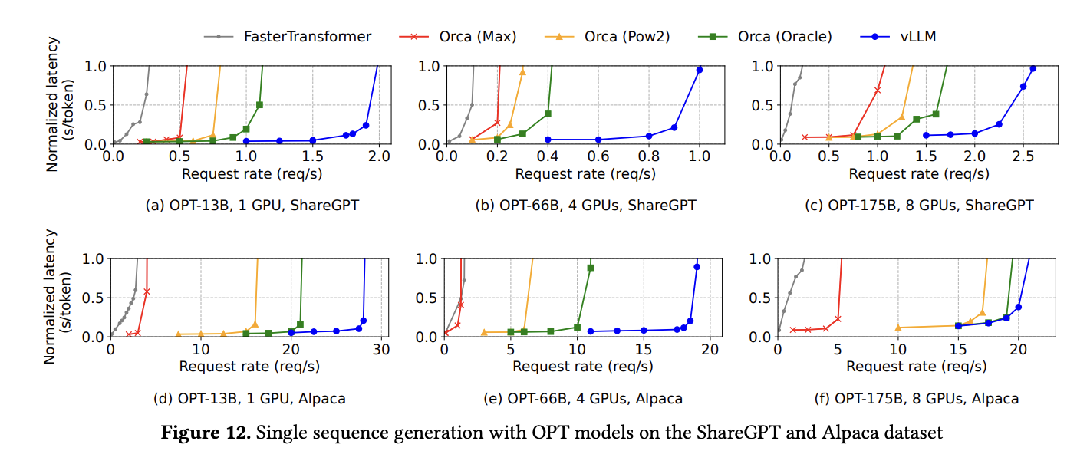
Evaluation-basic sampling
Behavior: request rate ⬆️, the latency initially ⬆️ at a gradual pace but then suddenly explodes.
vLLM with paged attention➡️ larger batch size➡️ 1.7×–2.7× throughput
Compute-bound
Notes:
In Fig. 12(f), vLLM’s advantage over Orca is smaller because the OPT-175B setup provides ample GPU memory for KV cache, while the Alpaca dataset has short sequences. As a result, both Orca variants batch many requests, making performance compute-bound rather than memory-bound.

Slide 25
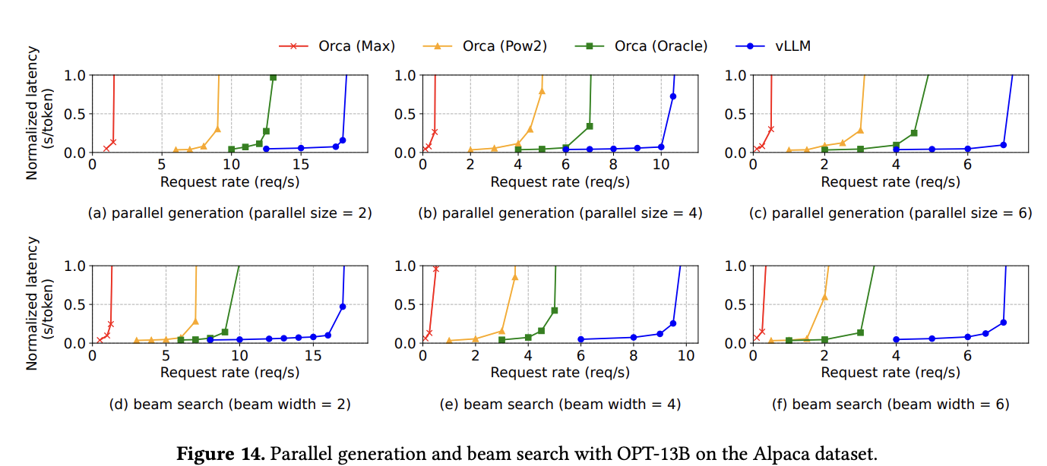
Evaluation-parallel sampling and beam search
Larger width(beam width=4/6)➡️ more prompt KV cache sharing➡️ more(1.8X/2.3X) improvement
Notes:
all parallel sequences in a request can share the KV cache for the prompt. larger

Slide 26
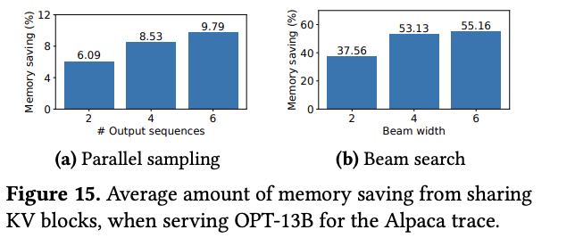
Evaluation-parallel sampling and beam search
memory saving
#(blocks saved by sharing)/ #(total blocks if no sharing)
vLLM supports sharing of prompt among requests

Slide 27
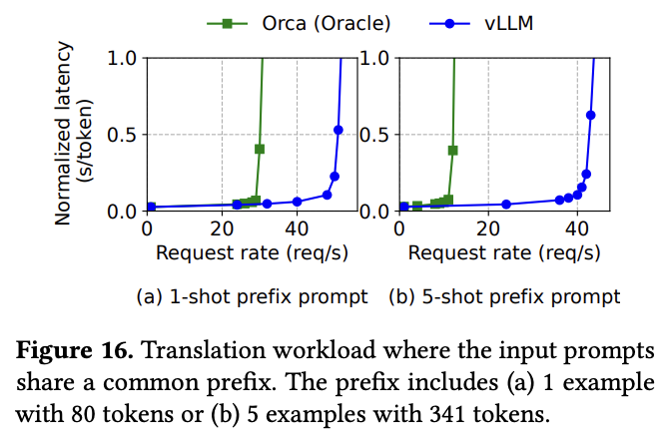
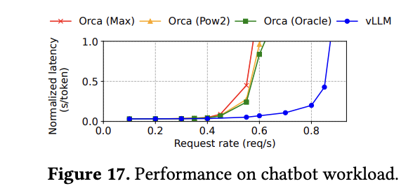
Evaluation-shared prefix & chatbot
Shared prefix (Figure 16)
More shots(shot=1 or 5) ➡️ more prompt KV cache sharing➡️ more improvement (1.8X/3.4X)
Chatbot (Figure 17)
1.5 X throughput compared with Orca(Oracle)
Notes:
Paged Attention resolves the problem of memory fragmentation and reservation.

Slide 28
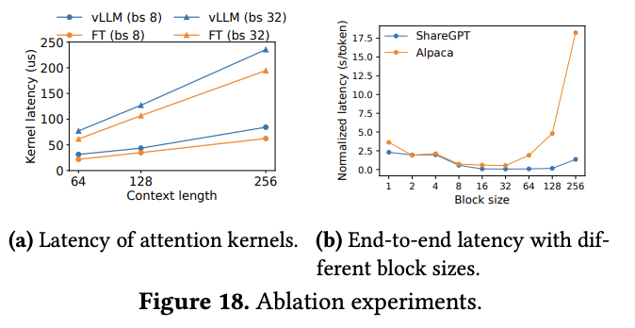
Ablation Studies
Kernel: Figure 18 a)
20–26% higher attention kernel latency, due to block read/writes.
blocksize: Figure 18 b)
Too small: not fully utilize the GPU’s parallelism for reading and processing KV.
Too large:internal fragmentation increases.

Slide 29
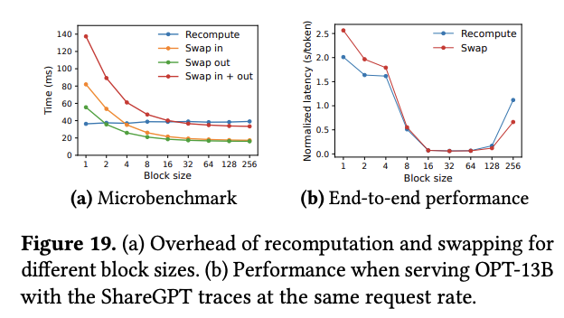
Ablation Studies
Recomputation and Swapping
a trade-off between computation and memory access
small block size (<16)
recomputation is better
low PCIE usage
large block size (>128)
swapping is better
medium (16-64)
either is fine
Notes:
small block size: because small block sizes often result in numerous small data transfers between CPU and GPU, which limits the effective PCIe bandwidth. large block size: the overhead of recomputation remains constant

Slide 30
Discussion: takeaways
Paged memory management can efficiently increase batch size by reducing memory fragmentation and reservation.
To fit the paged memory management, attention kernel in vLLM introduces 20% additional overhead.
Block size matters in memory management.
Swapping and recomputation is a trade-off.

Slide 31
Discussion: limitations
L1: The KV cache sharing pattern cannot support general tree-structured management.
only for the prompt.
L2: Continuous batching causes interference between prefill and decode
over-provision resources to meet the latency goal
L3: Throughput is not all you need
Goodput, the number of completed requests per second that adheres to SLOs (TTFT and TPOT requirements)

Slide 32
Discussion: future work
To solve L1➡️ reusing KV cache in a tree structure
Storage: SGLang supports tree-structured KV cache management
Memory access: DeFT supports IO reuse of tree-structured KV cache in attention calculation ➡️ latency speedup
To solve L2 and L3 ➡️ balance/decouple prefill & decode
Chunked-prefill: Sarathi-Serve
Prefill & Decode disaggregation: Distserve
Notes:
chunked-prefill: throughput ⬆️， TTFT & TPOT ⬇️
distserve: less interference, PCIE is the bottleneck

Slide 33
Part II: Taming Throughput-Latency Tradeoff in LLM Inference with Sarathi-Serve
Amey Agrawal, Nitin Kedia, Ashish Panwar, Jayashree Mohan,
Nipun Kwatra, Bhargv S. Gulavani, Alexey Tumanov,
and Ramachandran Ramjee
Microsoft Research India
Georgia Institute of Technology
Presenter: Yuxuan Zhu
Notes:
https://docs.google.com/presentation/d/1AIwLzghcCnBly7_Jl67u9o3QgvAvNTZH/edit#slide=id.p3

Slide 34
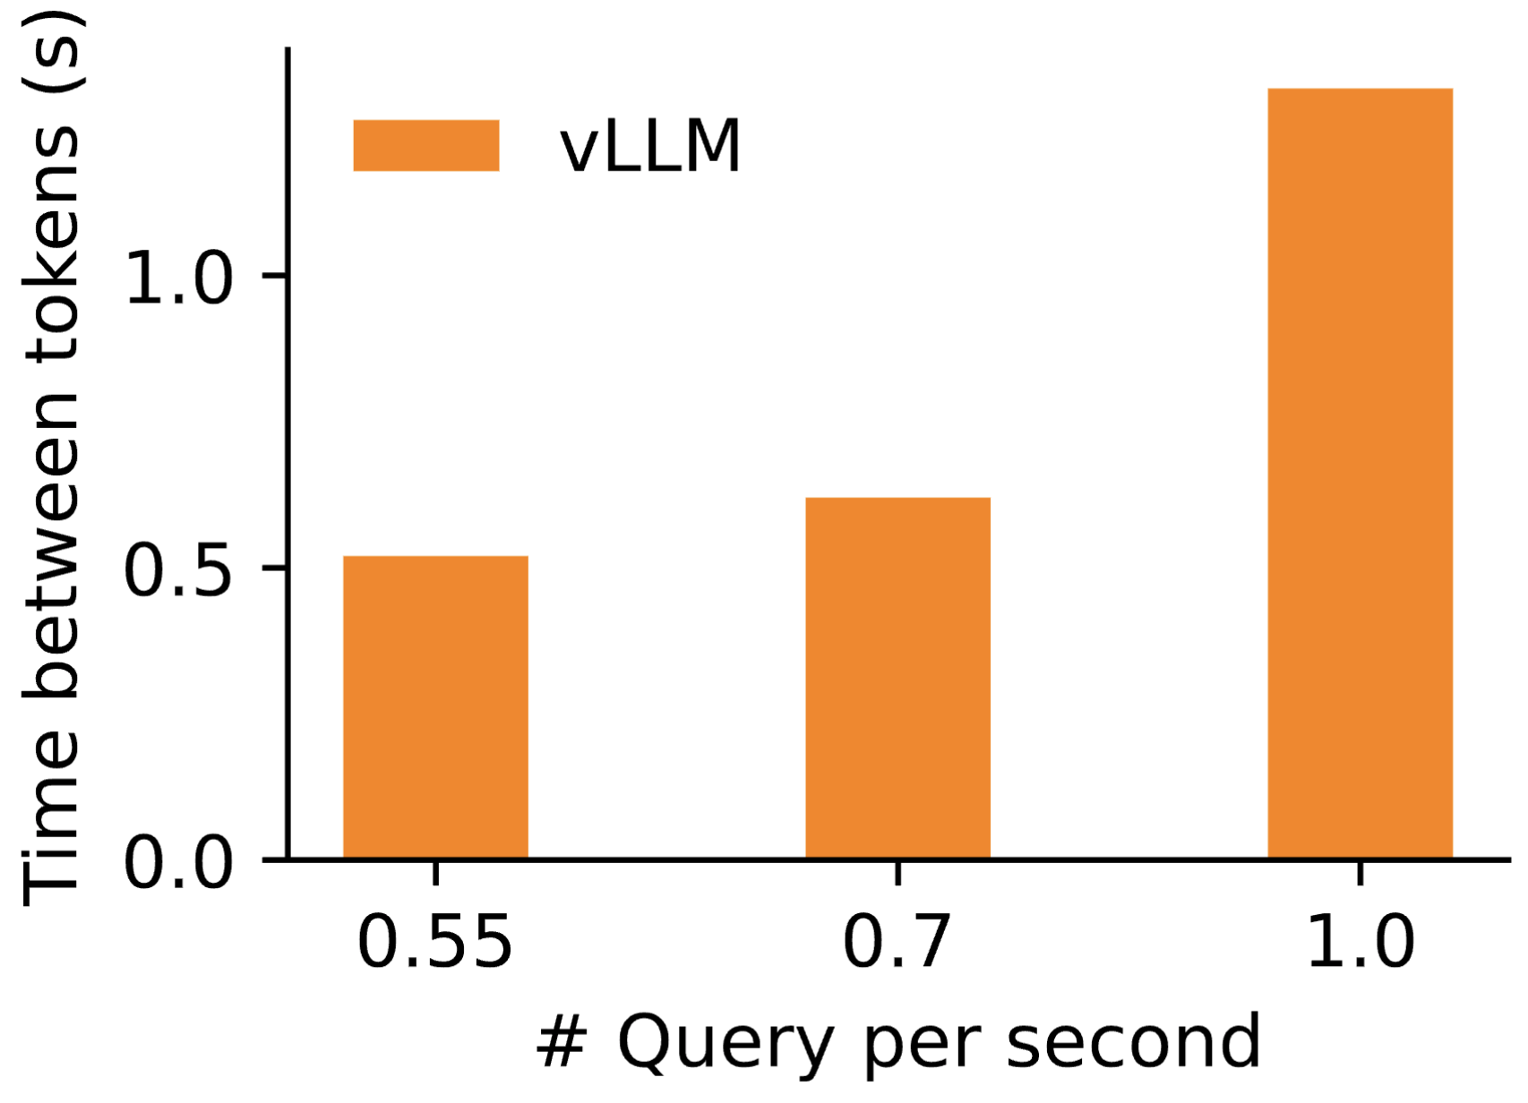
A Trade-off in LLM Inference
Throughput: # queries processed / second
Latency: time to generate a token
Both are important.
Can we achieve both?
Not really for the current SOTA …

Slide 35
Demystifying LLM Inference
Prefill
Decode
Iteration 0
Itr. 1
Itr. 2
Itr. 3
CS
598
FLA
is
the
greatest
course
Compute-bound
Parallelism 👍
GPU utilization 👍
Memory-bound
Parallelism 👎
GPU utilization 👎

Slide 36
Can We Improve the GPU Utilization of Decoding?
Yes. We can batch multiple queries during decoding.
Q1 Prefill
Q2 Prefill
Q1 Itr. 1
Q2 Itr. 1
Q1 Itr. 2
Q2 Itr. 2
Q1 Itr. 3
Q2 Itr. 3
time
Q3 Prefill
Now, we have the third query Q3. How to schedule?

Slide 37
Scheduling Strategy 1: Decoding-prioritizing
Q1 & Q2 complete
Q1 Prefill
Q2 Prefill
Q1 Itr. 1
Q2 Itr. 1
Q1 Itr. 2
Q2 Itr. 2
Q1 Itr. 3
Q2 Itr. 3
Q3 Prefill
time
Time between tokens 👍
Throughput 👎

Slide 38
Scheduling Strategy 2: Prefill-prioritizing
Q3 received, Q2 & Q1 stall
Q1 Prefill
Q2 Prefill
Q1 Itr. 1
Q2 Itr. 1
Q3 Prefill
Q1 Itr. 2
Q2 Itr. 2
Q3 Itr. 1
Q1 Itr. 3
Q2 Itr. 3
Q3 Itr. 2
Q3 Itr. 3
time
Time between tokens 👎
Throughput 👍

Slide 39
Key Idea 1: Stall-free Scheduling
We allow new queries to join running queries without stopping ongoing decoding.

Slide 40
Scheduling Strategy 2: Prefill-prioritizing
Q3 received
Q1 Prefill
Q2 Prefill
Q1 Itr. 1
Q2 Itr. 1
Q3 Prefill
Q1 Itr. 2
Q2 Itr. 2
Q3 Itr. 1
Q1 Itr. 3
Q2 Itr. 3
Q3 Itr. 2
Q3 Itr. 3
time
Mixture of prefills and decodes ⇒ bubbles in pipeline-parallelism.
Wasted GPU cycles, throughput 👎

Slide 41
Pipeline Bubble Issues: Zoom in
GPU0
Q1 Prefill
Q2 Prefill
Q1 Itr. 1
Q2 Itr. 1
GPU1
Q1 Prefill
Q2 Prefill
Q1 Itr. 1
time
Q1 prefill > Q2 prefill
Q2 prefill > Q1 Itr. 1
Unequal execution time ⇒ Bubbles in the pipeline

Slide 42
Key Idea 2: Chunked-prefills
We split a prefill into equal chunks and compute it over multiple iterations.

Slide 43
Outline
Problem
Motivation
Methods: Sarathi-Serve 👈
Chunked-prefills
Stall-free batching
Evaluation
Discussion

Slide 44
Chunked-prefills: Challenges
Challenge: Decoding iteration is not computing intensive
⇒ bubbles in the pipeline parallelism
Q1
Itr. 1
Bubble
GPU0
Q2 Prefill
GPU1
Q1
Itr. 1
Q3 Prefill
GPU0
An naive solution: decodes + prefills
Q2 Prefill
GPU1
Problem: high time-between-token (latency)
wrose if prefill is large (prompt > 1K)
long latency

Slide 45
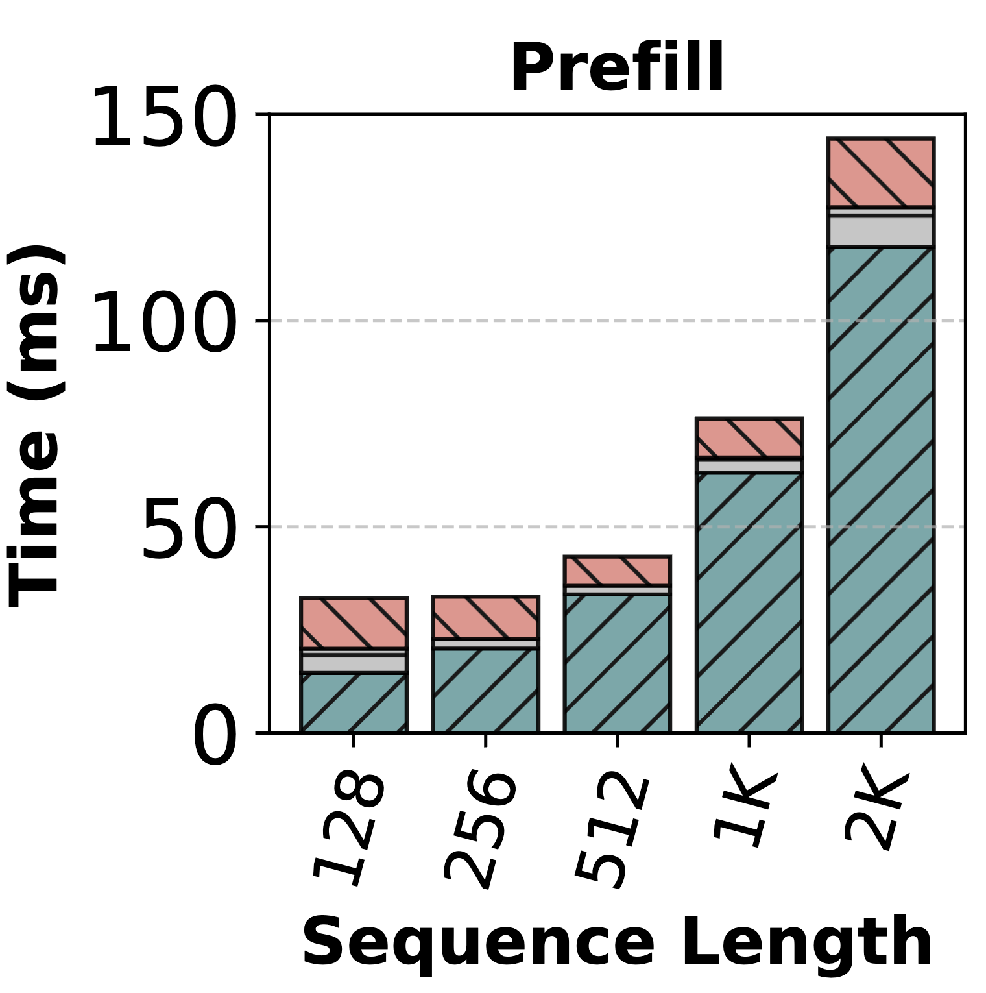
Chunked-prefills: Mechanism
Q1
Itr. 1
Bubble
GPU0
Challenge: bubbles in the pipeline parallelism
Q2 Prefill
GPU1
Chunked-prefills: split a prefill into middle-size chunks
Throughput saturates at middle sizes.
Average prompt length can be > 1K.
Q1
Itr. 1
Q1
Itr. 2
Q1
Itr. 3
GPU0
Q2 Prefill
GPU1
Dataset | Prompt len.
openchat | 1730
arxiv | 7059

Slide 46
Stall-free Batching: Challenges
Challenge: Prioritizing prefills leads to long latency
Q3 & Q4 received
Q1 & Q2 finished
Q1 Itr. 1
Q2 Itr. 1
Q3 Prefill
Q4 Prefill
Q1 Itr. 2
Q2 Itr. 2
Q3 Itr. 1
Q4 Itr. 1
Unnecessary waiting time for Q1 and Q2

Slide 47
Stall-free Batching: Example
Note: Prefills are chunked into middle sizes.
Q3 & Q4 received
Q1 finished
Q2 finished
Q1 Itr. 1
Q2 Itr. 1
Q1 Itr. 2
Q3 Prefill 1
Q2 Itr. 2
Q3 Prefill 2
Q3 Itr. 1
Q4 Prefill 1
Prioritize chunked prefills + running decodes

Slide 48
Stall-free Batching: Make It Formal
User specifies a budget of maximum number of tokens per batch.
Scheduling policy:
For every query with a running decoding:
+1 token
For every query with a running prefilling:
+1 prefill chunk
If there is remaining budget:
+1 prefill chunk from a new query
Principle:
Non-stall decoding
Prefill-prioritizing
First come first serve

Slide 49
Stall-free Batching: Determine The Token Budget
Trade-offs:
a smaller budget minimizes time-between-token
a larger budget is better for chunked-prefills
suppose a N-chunk prefill:
# KV-cache access for the 1st chunk: N-1
# KV-cache access for the 2nd chunk: N-2
…

Slide 50
Stall-free Batching: Determine The Token Budget
Trade-offs:
a smaller budget minimizes time-between-token
a larger budget is better for chunked-prefills
the tile-quantization effect can influence pre-fill time
GPU thread 1
Matrix
GPU thread 2
Maximum utilization
GPU thread 3
GPU thread 4

Slide 51
Stall-free Batching: Determine The Token Budget
Trade-off:
a smaller budget minimizes time-between-token
a larger budget is better for chunked-prefills
the tile-quantization effect can influence prefill time
GPU thread 1
Extra computation blocks everything
Matrix
GPU thread 2
GPU thread 3
Token budget: 256 → 257
32 % increase of prefill time
GPU thread 4

Slide 52
Stall-free Batching: Determine The Token Budget
Trade-offs:
a smaller budget minimizes time-between-token
a larger budget is better for chunked-prefills
the tile-quantization effect can influence prefill time
a larger budget leads to higher inter-batch runtime variations
An ad-hoc solution for this complex problem: profiling and simulating

Slide 53
Outline
Problem
Motivation
Methods
Evaluation 👈
Settings
Capacity
Throughput-latency Trade-off
Deployments
Ablation
Discussion

Slide 54
Evaluation: Settings
Models: Mistral-7B, Yi-34B, LLaMA2-70B, and Falcon-180B
Workloads: generate traces for real-world serving scenarios
openchat_sharegpt4: conversions on ChatGPT-4 ⇒ Chatbots
arxiv_summarization: publications and summary ⇒ API / Batch
Metrics: median value of time-to-first-token (TTFT)

Slide 55
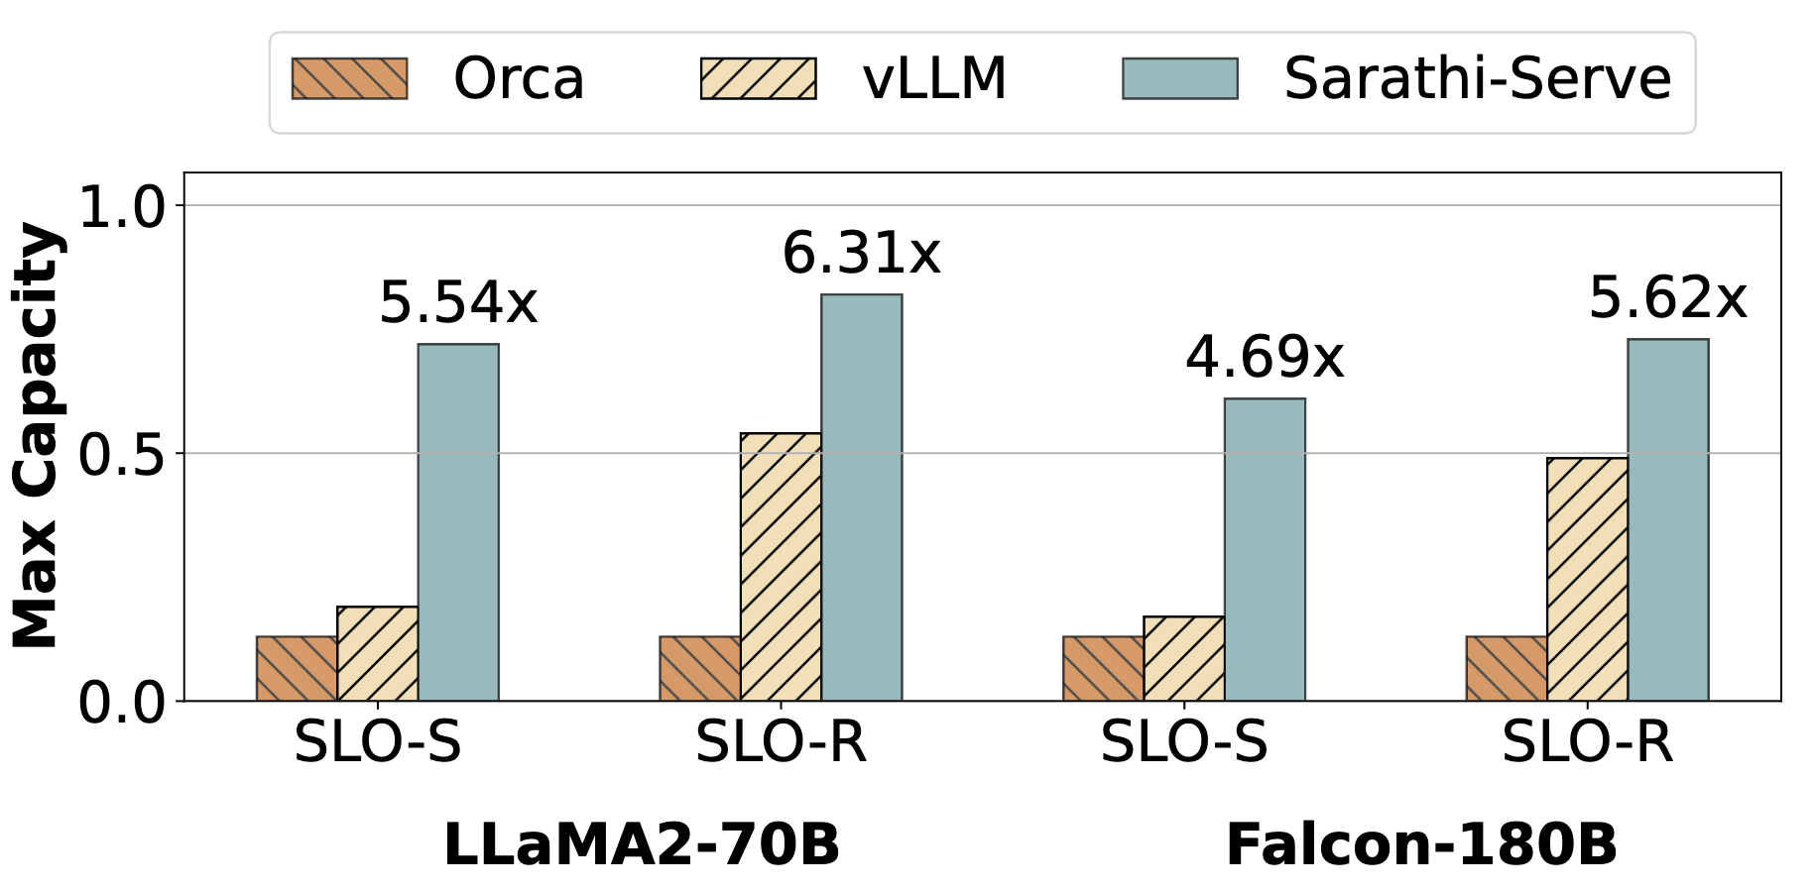
Evaluation: Capacity
Research Question: What is the maximum throughput we can server under a fixed service level objective (latency) constraint?
up to 6.3x higher throughput than Orca
up to 4.3X higher throughput than vLLM

Slide 56
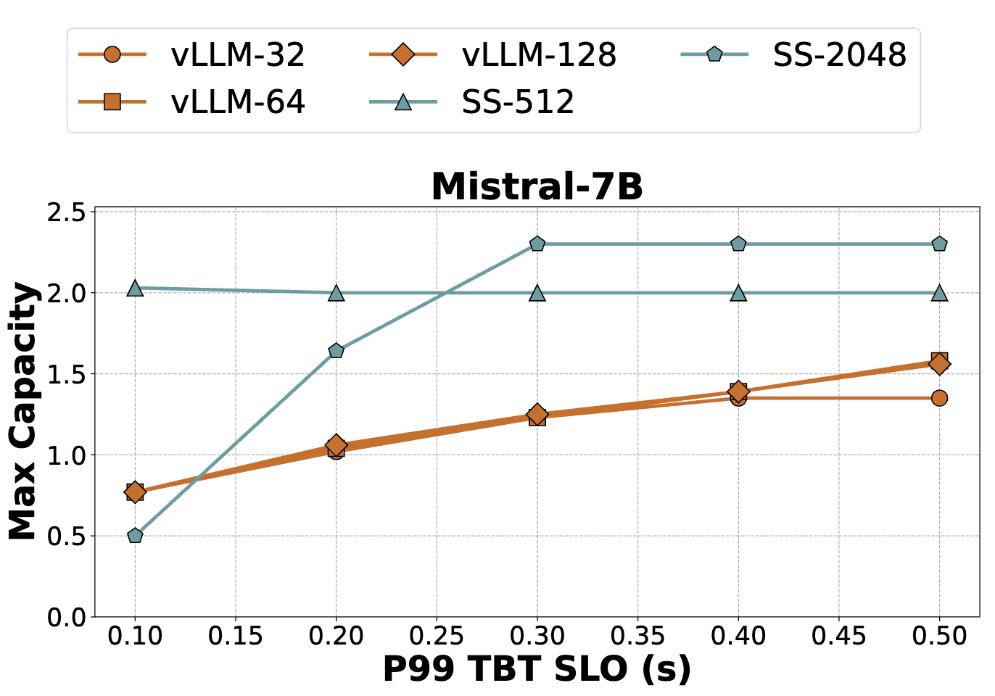
Evaluation: Throughput-Latency
Research Question: How does the throughput vary with different service level objective (latency) constraint?
budget=512: 3.5X higher throughput than vLLM (Mistral-7B, 100ms)
budget=2048: 1.65X higher throughput than vLLM (Yi-34B, 1s)

Slide 57
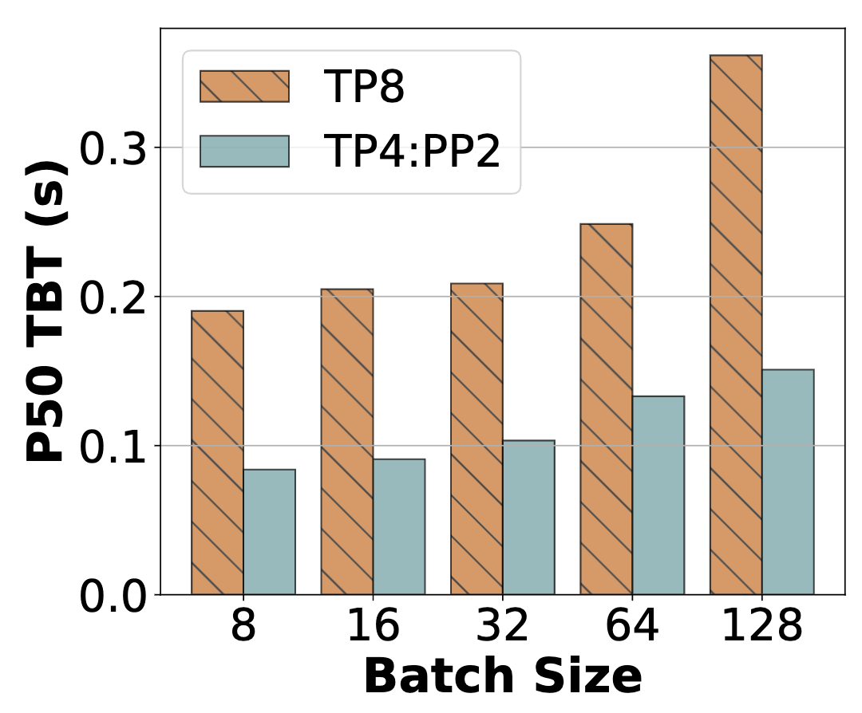
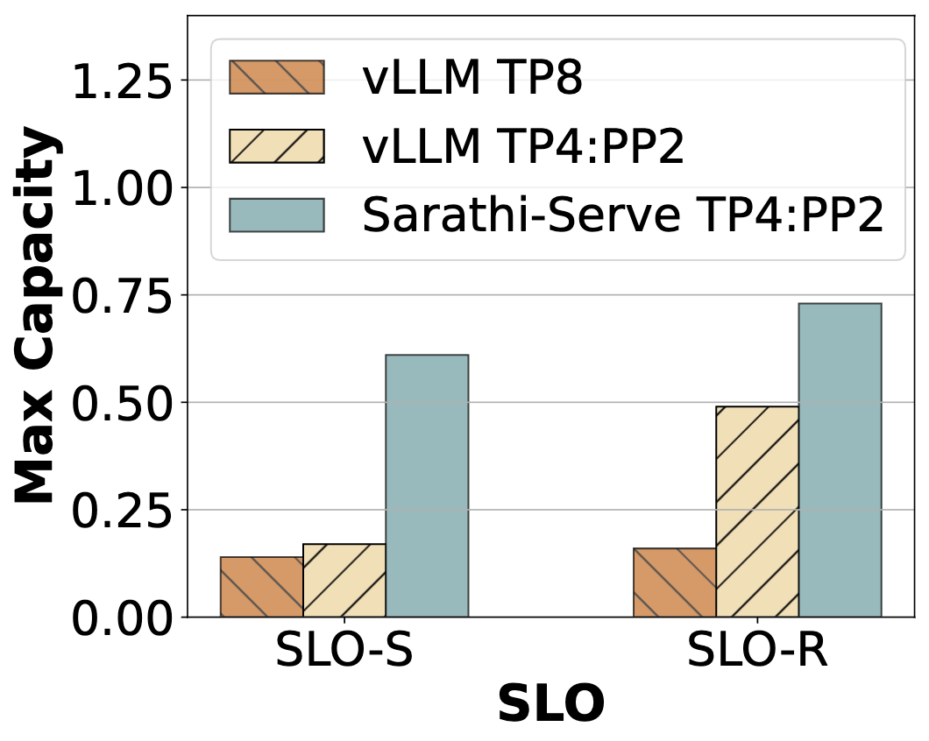
Evaluation: Deployments
Research Question: How is the performance under deployment scenarios: TP and PP?
Latency of TP is 2X higher due to communication overheads.
Our throughput is 1.5-3.6X higher due to fewer pipeline bubbles

Slide 58
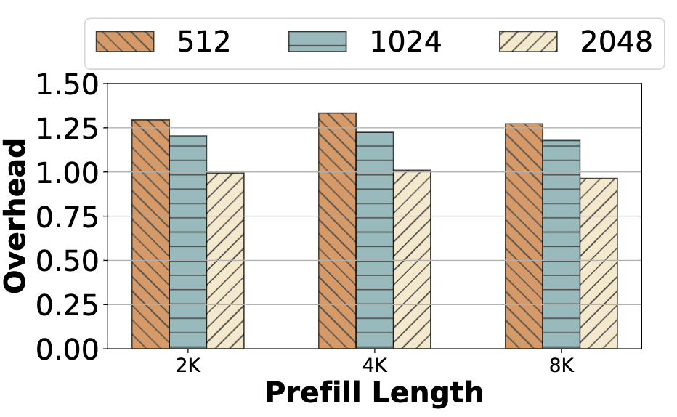
Evaluation: Ablation
Research Question: (1) effect of chunking on prefill throughput;
(2)the impact of stall-free batching and chunking on latency
Scheduler | TTFT | TBT
no prefill chunking | 0.53 | 0.68
no stall-free batching | 1.04 | 0.17
Sarathi-Serve | 0.76 | 0.14
small chunk size: 25% overhead
large chunk size: negligible overhead
All components contributes to lowering latency

Slide 59
Discussion & Conclusion
Principle of the technique: fine-grained management of resource
In traditional systems: file system, database, memory, …
In LLM serving: KV-cache (paged Attention), GPU computation (Sarathi)
Two key challenges
How can we divide resource into small chunks?
How can we carefully manage resource to mitigate the issue of over-fragmentation?
Future work: (1) Automatic budget allocation; (2) Dynamic adjustment.

